Slide 1
Language Arts/ Science Collaborative Essay
Directions & Expectations

Slide 2
Paper Expectations
Paper should be 1 to 2 pages in length (double spaced)
At least 3 paragraphs (introduction, body, conclusion)
Contain at least 2 in-text citations
Contain a Work Cited Page
12 point font in Times New Roman
1” margins on each side
Header with name and page number
Be well written

Slide 3
In-Text Citation
In text citations are typed after you write ANY information that isn’t common knowledge that someone else thought of first.
They contain the author’s last name and the page number. If an author’s name isn’t present, use the title of the article instead.
Most WebPages won’t have page numbers, so they aren’t necessary.
See sample paper

Slide 4
How to double space
Click on the “Home” tab
Click on the icon that has the double headed arrow going vertically and click on “2.0”
Do this before typing anything

Slide 5
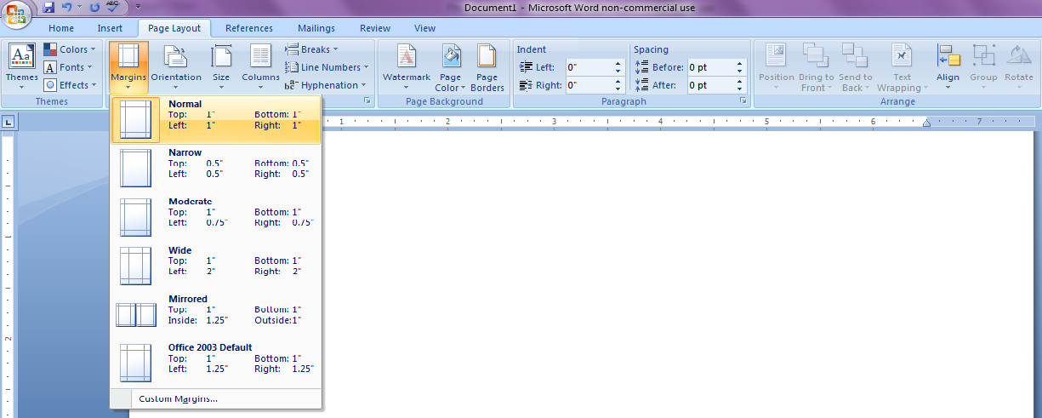
Get 1” Margins
In the “Page Layout” tab, click on “Margins”
Select “Normal”

Slide 6
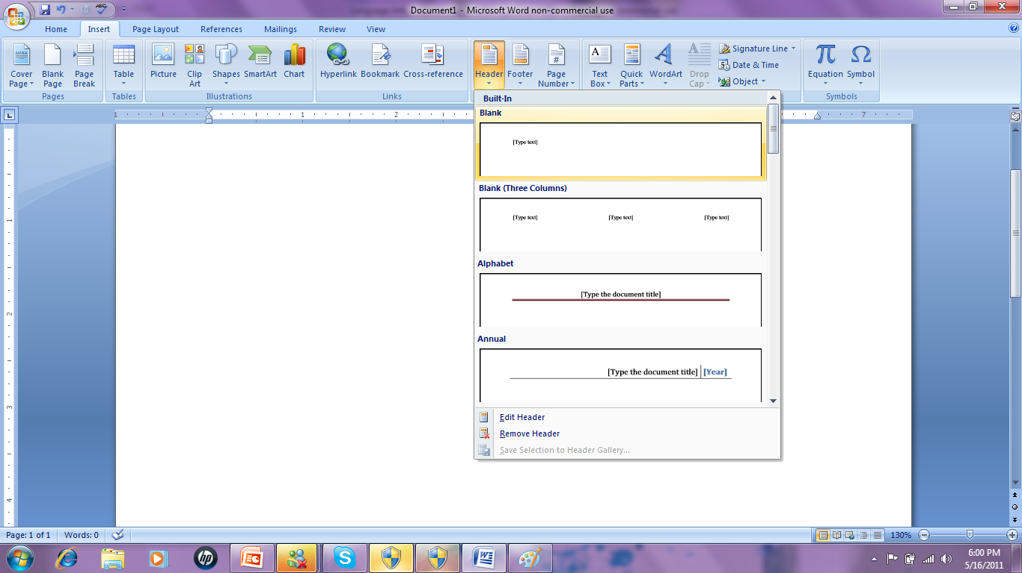
How to add a header
In the “Insert” tab, click on “Header”
Select “Blank”

Slide 7
Personalizing Header
Click on [Type Text]
Type your last name
Double click
Click on the icon for right alignment in the “Home tab” right above “Paragraph”

Slide 8
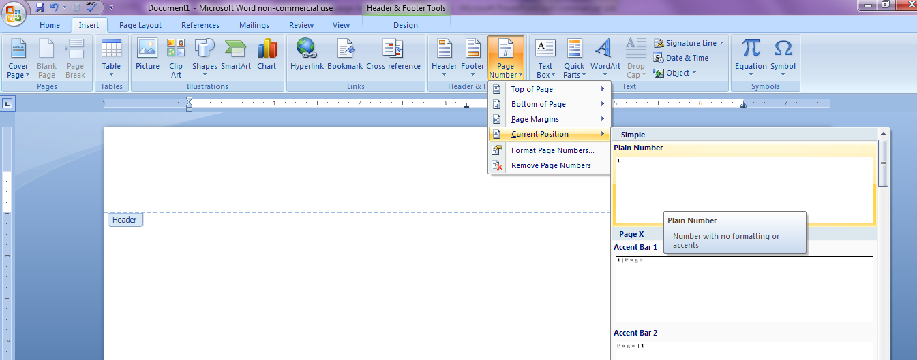
Add page numbers
Click the cursor right after your last name, then hit the space bar one time
On the “Insert” tab
Click on “Page Number”
Click on “Current Position”
Select “Plain Number”

